Slide 1
Complex compounds
SAIKRISHNA UGGU
Lecturer in Chemistry
P. R. Govt. College (A)
KAKINADA

Slide 2
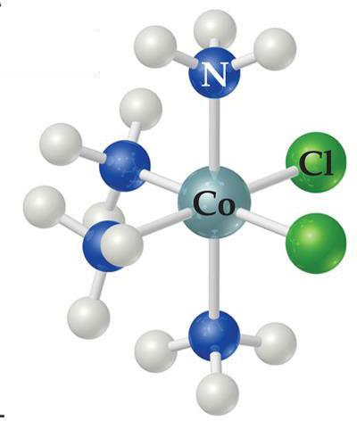
Complex Compounds
Coordination compounds or complex compounds contain coordinatecovalent bonds formedbetweenmetalionswithgroupsofanions or polar molecules.
Acentralmetalatombondedto agroupofmoleculesor ions is a metal complex.
The molecules or ionscoordinating to the metalarethe
ligands.
Metal ion – Lewis acid
Bonded groups – Lewis base
Ligandmust have lone pairs to interact with metal
Theliganddonatesalonepairofelectrons toanempty orbital of the metal ion to form a coordinate covalent bond

Slide 3
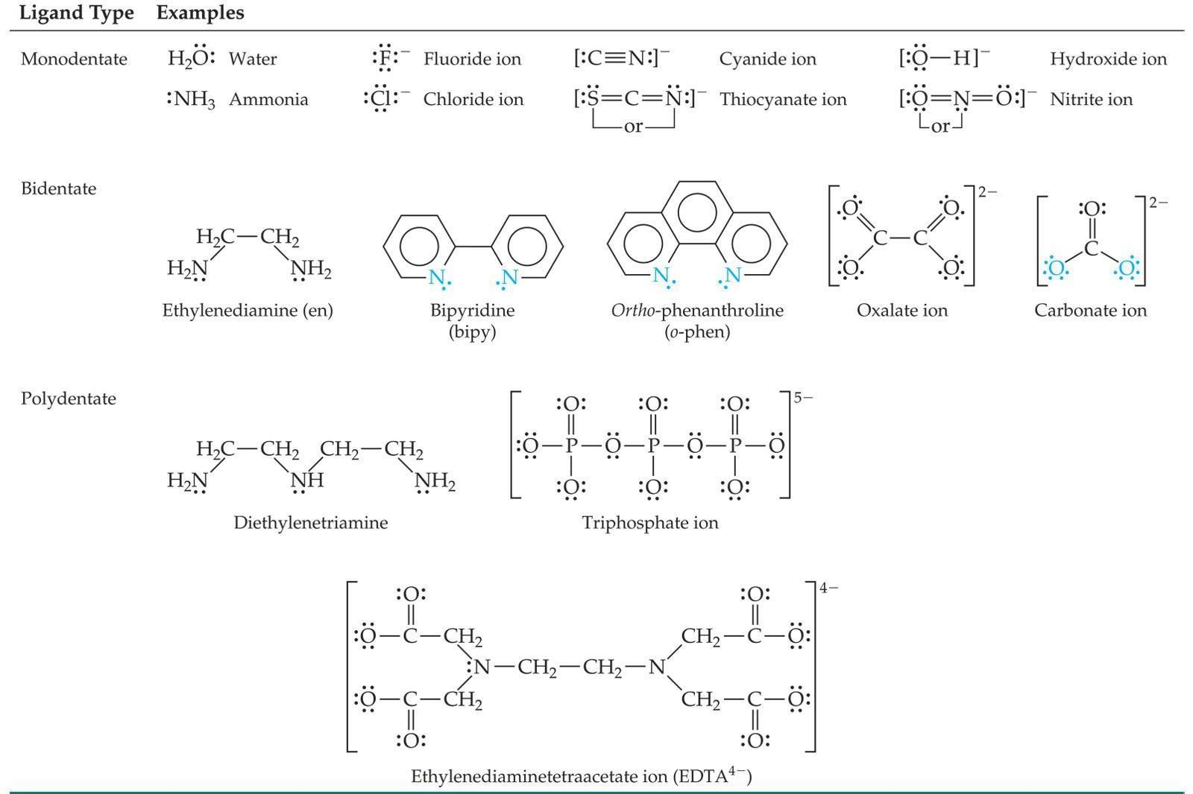
Ligands

Slide 4
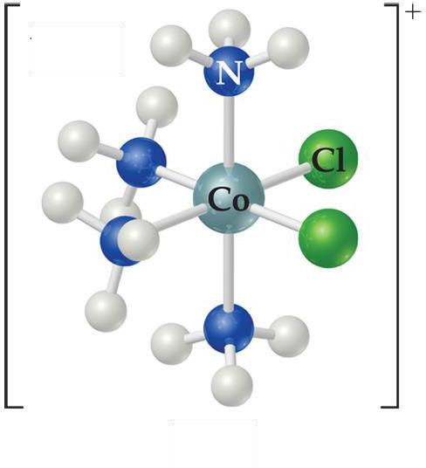
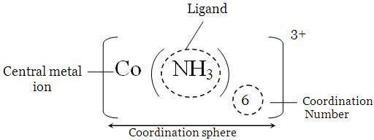
Werner’s Theory
Suggestedthatmetalionshave primaryand secondaryvalences.
Primary valence equal the metal’s oxidation number
Secondary valence is the number of atoms directly bonded to the metal (coordination number) and placed those molecules and ions within the sphere in brackets
“free” anions (that dissociate from the complex ion) outside the bracket

Slide 5
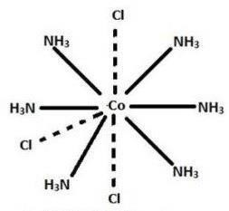
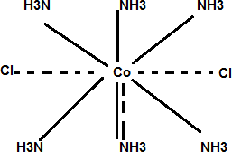
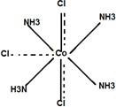
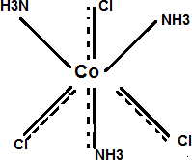
CoCl₃.6NH₃ = [Co(NH₃ )₆ ](Cl₃)
Many coordination compounds are having same metal, same ligands
Compound1:
Cl⁻ isnotincoordinationsphere 3 free Cl⁻ ions,[Co(NH₃)₆]³⁺
Orange colour
Compound2:
CoCl.5NH = [Co(NH ) Cl](Cl)
3 3 3 5 2
2 free Cl⁻ ions,[Co(NH₃)₅Cl]²⁺
Purple colour
Compound3:
CoCl₃.4NH₃ = [Co(NH₃ )₄ C₂l ](Cl)
1 free Cl⁻ ion,[Co(NH₃)₄Cl₂]¹⁺
Green Colour
Compound4:
CoCl₃.3NH₃ = [Co(NH₃ )₃ C₃l ]
No free Cl⁻ ions

Slide 6
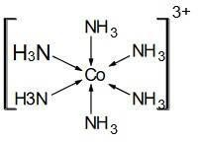
Effective atomic number (EAN) Rule :
The sum of the electrons on the central atom (Lewis acid) including those donated from the ligands (Lewis base) should be equal to the number of elctrons on a noble gas element found in the same periodin whichthe metalissituated.
Let us take the case [Co(NH₃)₆]³⁺ Oxidationstateof Co in[Co(NH₃)₆]³⁺ = +3 No. of electrons in Cobalt= 27
∴No. of electronsin Co(III) of the complex = 27−3 = 24
Number of electronsdonatedby six NH₃ ligands= 6×2 = 12
∴EAN ofCo(III) in[Co(NH₃)₆]³⁺ = 24+12 = 36Noblegas(Kr),
∴ [Co(NH₃)₆]³⁺ follows the EAN rule
Drawbacks:
The donation of electron pairs to central metal ion produce an improper accumulation of negative charge on this ion. Such condition is not fair.
Some complexes i.e., Ni(II), Co(II) are not follow the EANrule, even then they are stable
Metals are electro positive in nature, then how they many accept electrons from ligands-not explained?

Slide 7
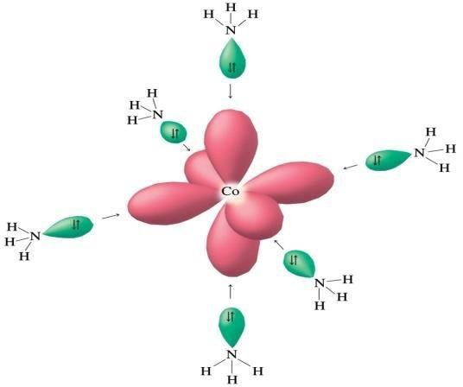
Valence BondTheory
Valence Bond Theory predicts Atomic orbitals undergo hybridizationand form new hybrid orbitals
Then, hybrid orbitals (filled ligandorbitals) overlap with vacantorbitalsof metal and form chemical bond

Slide 8
Hybridization & geometry of the Complex
CN | Geometry | Hybridorbitals | Example
2 | Linear | sp | [Ag(NH₃)₂]⁺
4 | Tetrahedral | sp³ | [CoCl₄]²⁻
4 | Squareplaner | dsp³ | [Ni(CN)₄]²⁻
6 | Octahedral | d²sp³ orsp³d² | [Co(H₂O)₆]²⁺
3d⁵
4s¹
4p⁰
Ground state Cr
3d⁶
4s⁰
4p⁰
Excited state Cr(0)
Hybridization state
Electrons donated by
ligand 'CO'
d²sp³ hybridization = octahedral geometry

Slide 9
Drawbacks-VBT
Why in some complexes the electrons must be rearranged against Hund’s Rule?-not explained
Existenceof innerandouterorbitals-notexplained
In some complexes, transfer of electron from lower energy level to higher energy level taken place, even in absence of energy supplier
ex:[Cu(NH3) ]²⁺
4

Slide 10
Crystal FieldTheory
Focuses on the effect of ligands on the energies of the d orbitals of metals.
Assumptions
Ligands are negative point charges.
Metal–ligand bonding is 100 ionic:
strong-field (low–spin):
weak-field (high–spin):
large splitting of d orbitals small splitting of d orbitals
Crystal field theory explains the bonding in complex ions purely in terms of electrostaticforces.
Attraction between the metal ion (atom) and the ligands
Repulsion between the lone pairs on the ligands and the electrons in the d
orbitals of themetal
In the absence of ligands, the d orbitals are degenerate
In the presence of ligands, electrons in d orbitals experience different levels of repulsion for the ligand lonepairs
As a result (Depending on the geometry) some d orbitals attain higher energy and others lowerenergy

Slide 11
Octahedral Complexes
•
d 2
and d
orbitalshavemaximumelectrondensityalong
z
_{x}2 _{y}2
theaxisandpoint-chargeligandsalsoapproachingcentral metalion in same direction –
Hence,thesed-orbitalsexperiencestrongerrepulsionsand increase inenergy
d_{xz},d_{yz},and d_{xy} orbitalslobesarein betweentheaxisesand
pointchargeligandsare approaching centralmetalion in samedialongtheaxis- Theseorbitalsexperienceless repulsions and decrease in energy
d ,d ,and d
xz yz xy
•
Theorbitals
are at a lower energy in the
octahedral complexthan are the
d and d
_{z}2 _{x} 2 _{y} 2
orbitals

Slide 12
The ligands are between the lobes of dxy, dyz and dzx orbitals. Hence, they Interact less strongly

Slide 13
Now, think of point charges being attracted to metal nucleus Positive charge. Whataboutelectronsindorbitals?
Energydifferencebetweenthe two sets is equal to _{O}.
The t_{2g} setisloweredby 0.4 _{O}andthe e_{g} setisraised by 0.6 _{O}.

Slide 14
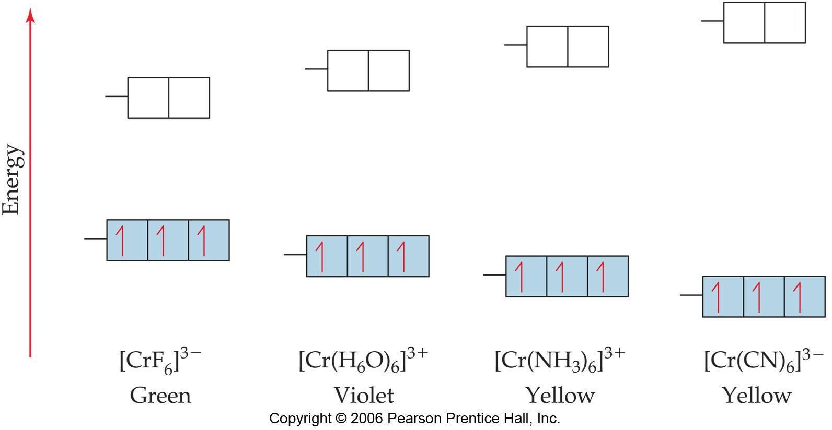
Splittingofdorbitalsinanoctahedral ligandfield
Large Δ Strongfield ligands
Spectrochemical Series

Slide 15
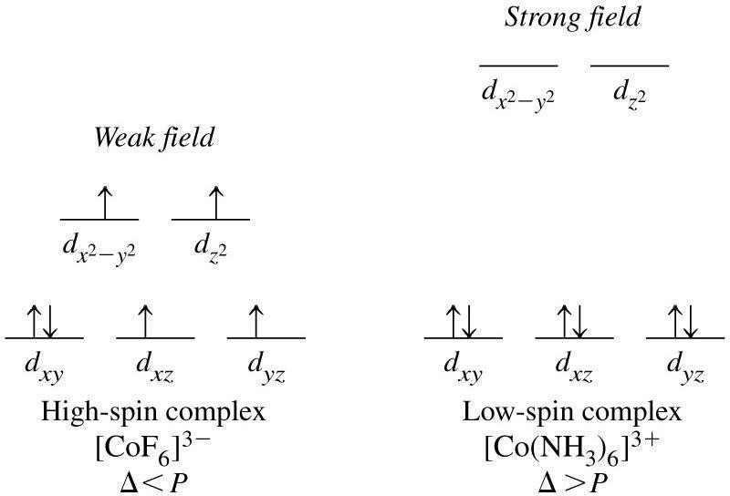
Weakand Strong Field Ligands
d⁶ - Complexes

Slide 16
Limitationsof CFT
Asaligandareassumedtobe pointcharges,itisexpected thattheionic ligand shouldhavegreatersplittingeffect.Howeveractuallytheyfoundto be at lower end of the spectrochemical series.
According to CFT metal– ligands bonding is purely electrostatic. Which is not sotrue.
CFTtakesonlyd-orbitalsofcentralatomintoaccount.Thesandporbits are not considered forstudy.
Though OH– in the spectrochemical series lies below H₂O and NH₃, yet it produces greater splittingeffect.
CFT gave no information about π bond formation in ligand.

Slide 17
Thank You……

